Slide 1
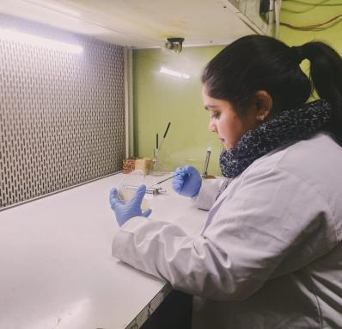
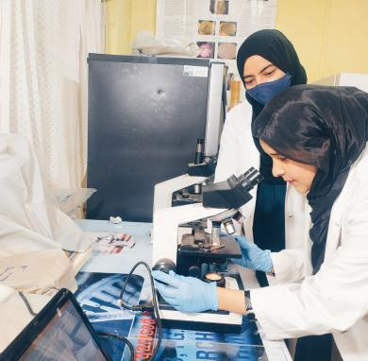
CENTRE OF RESEARCH FOR DEVELOPMENT & P.G. PROGRAMME IN MICROBIOLOGY, UNIVERSITY OF KASHMIR, SRINAGAR
COME WITH US AS WE JOURNEY DOWN THE PATH OF EXCELLENCE TO UNCOVER THE POSSIBILITIES AWAITING YOU IN FIELD OF RESEARCH & DEVELOPMENT
PLACEMENT BROCHURE
2024
Arrive to gain knowledge, depart to contribute through service
1

Slide 2
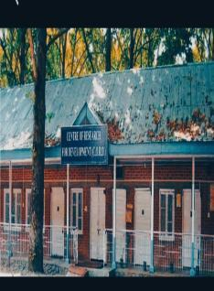
ABOUT US
Centre of Research for Development was established in the year 1979. Being a multidisciplinary Centre, faculty of the Centre is working in different disciplines and areas of Research. Teaching programme in Environment Science was started by the center in 2001 with an intake capacity of 16 students which has risen to 25 students and now is a fullfleged department & DST- FIST Assisted. The Centre has also started M.Sc Microbiology Programme in 2017 with the intake capacity of 15 students. This Centre is now offering the PhD programme in Microbiology in addition to Zoology, Botany and Biochemistry.
Centre of Research envisages to continue its unflinching march towards excellence through augmentation of its faculty strength, expansion of its existing infrastructure, modernization of its laboratories, industry-academia collaborations, quality research activities, publication of research in high impact journals, providing greater opportunities to its students for their career advancement and seeking more financial assistance through research projects and programmes. This Research Centre aims to carve a niche for itself in the national arena of Multidisiplinary Sciences and has emerged as an institution of repute and excellence.
To Excel in Research/ teachimg and provide high quality trained manpower to serve the society
V i s i o n
M I S S I O N
To Strive for academically standard research
To strengthen R&D base of the research
To provide inspiring research/ teaching environment for quality learning designed for career development and well being of students
2

Slide 3
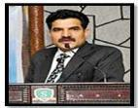
T
Message from Director
It gives me immense pleasure to welcome you to the Centre of Research for Development, University of Kashmir, Hazratbal, Srinagar.This Centre has been catering Masters and Ph.D programme since 1979.
The goal of our Centre is to render professional skill, knowledge, abilities to students to serve the society in different fields like higher education, agriculture, health sector, environment and industries. The curriculum aim of the Centre is to investigate and understand the fundamental processes governing life at the molecular level through interdisciplinary approaches that integrate Biology, Environmental sciences, Microbiology and Bioresources.
Prof. Bashir Ahmad Ganai
PLACEMENT BROCHURE
2024
The academic postgraduate two year Masters in Microbiology program provides an in-depth adequate knowledge & scientific research updates including basic principles & advances Fundamentals of Microbiology, Genetic Engineering & Genomics, Biochemical Techniques, Biostatistics, Immunology & Medical Microbiology and other interrelated disciplines. The Department also offers doctorate (PhD) in many subjects viz: Zoology, Botany, Biochemistry, Environmental Sciences, Microbiology, Bioresource. Our Centre has highly qualified, experienced and research-oriented faculty. It also ignites inbuilt abilities & potentialities in students and prepares highly competent biologists who can serve in different biological fields globally.
I welcome all the students and extend my warm wishes to one and all associated with the Centre of Research for Development at University of Kashmir.
(Prof. Bashir Ahmad Ganai)
4
3

Slide 4
Why to Recruit Our Students
Diverse Skill Set: Life sciences students often possess a diverse skill set, including critical thinking, problem-solving, and laboratory techniques, which are valuable in various industrial sectors and other societal issues such as pharmaceuticals, biotechnology, healthcare, sustainable agriculture and climate change.
Innovation and Research: Life sciences students are trained in research methodologies, allowing them to contribute to innovation and advancements in fields like medicine, agriculture, biodiversity and biotechnology.
Adaptability: The interdisciplinary nature of our centre’s education, equips students with adaptability and the ability to work in diverse environments, making them well-suited for roles that require flexibility and the capacity to learn quickly.
Ethical Considerations: Life sciences education often includes discussions on ethical considerations in research and practice, which is crucial in industries where ethical decision-making is paramount, such as healthcare and biotechnology.
Demand in Various Sectors: With the increasing focus on health, sustainability, and technological advancements, there is a growing demand for professionals with expertise in different sciences across multiple sectors, making our graduates highly sought after by employers.
PLACEMENT BROCHURE
2024
7

Slide 5
Outside University of Kashmir Within University of Kashmir
Accreditations & Collaborations
Jamia Hamdard, New Delhi
IHBT-Palampur
Government Medical College, Srinagar
Central Silk Board, Pampore & TI
IIIM, Srinagar
SKIMS, Soura Srinagar
SKUAST-K Shalimar
Barkatullah University, Bhopal
Punjabi University Patiala Punjab
Pondicherry University, Puducherry
NIT, Srinagar
Government Medical College, Baramulla
Department of Botany
Department of Zoology
Department of Biotechnology
Department of Biochemistry
Department of Clinical Biochemistry
Department of Environmental Sciences
Department of Chemistry
Department of Geography & Reg. Development
Institute of Home Science
Department of Nanotechnology
Department of Bioresources

Slide 6
Infrastructure/ Facilities
O Departmental Library
O Classrooms with Projector Facility
O Computer Room
O Seminar Hall
O P.G. Laboratory
O Research Laboratories of the Centre : 07
O Girls Common Room
PLACEMENT BROCHURE
2024
8
5

Slide 7
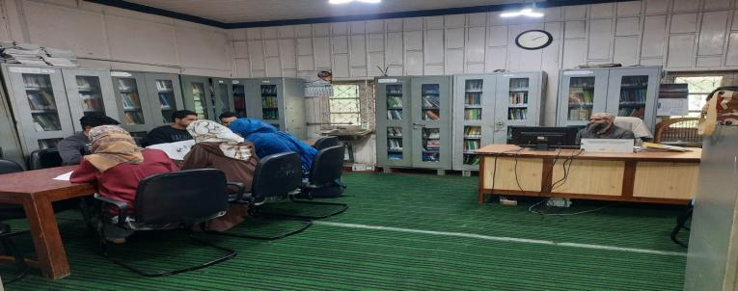
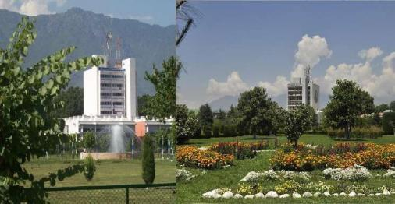
PLACEMENT BROCHURE
2024
9
Central Library (Allama Iqbal Library)
6

Slide 8
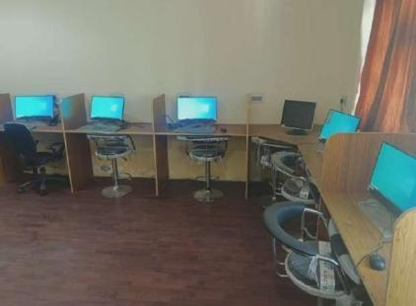
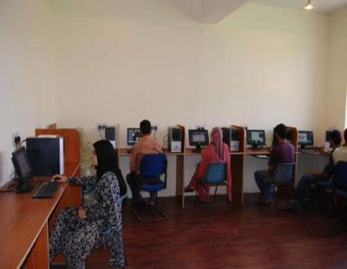
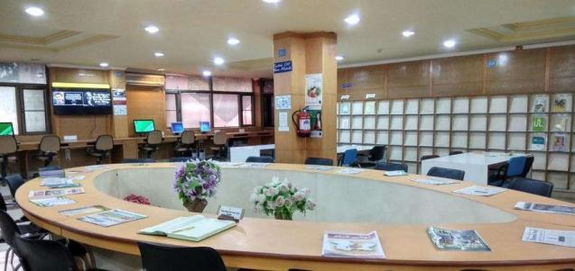
PLACEMENT BROCHURE
2024
Computer Lab with Internet Facility
10
7

Slide 9
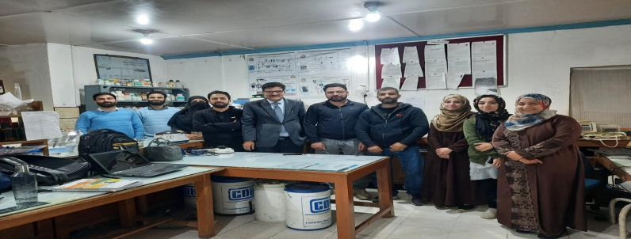
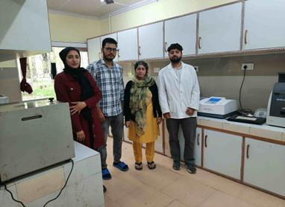
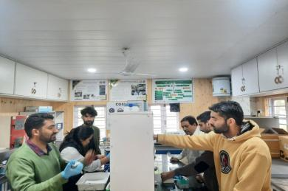
PLACEMENT BROCHURE
2024
Biochemistry Lab
11
Tissue Culture Lab
Cosi Lab
8

Slide 10
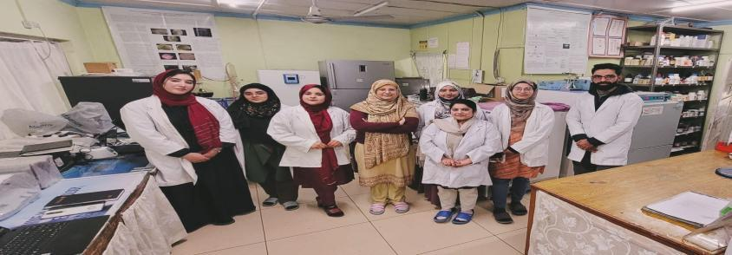
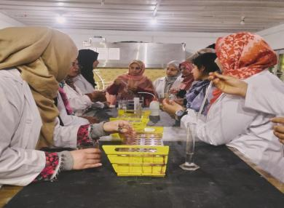
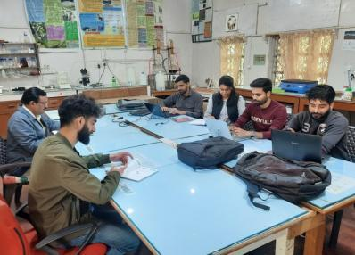
PLACEMENT BROCHURE
2024
Microbiology Research Lab
P.G. Microbiology Lab
Cytogenetics Lab
9

Slide 11
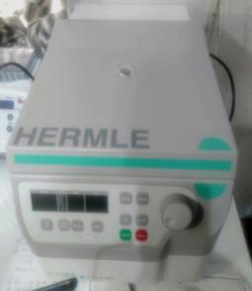
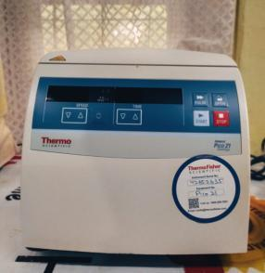
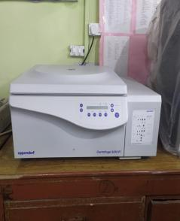
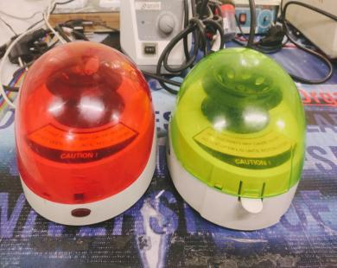
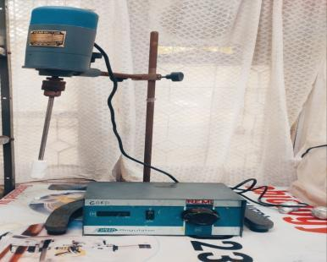
Minicentrifuge
Gel Doc
Centrifuges
PLACEMENT BROCHURE
2024
HPTLC
12
BOD Incubator
Mini Centrifuges
Homogenizer
10

Slide 12
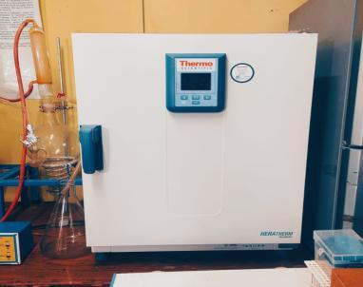
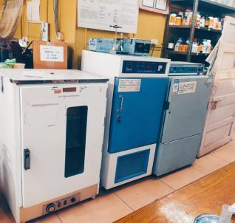
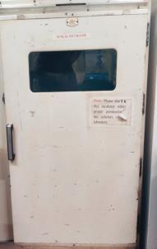
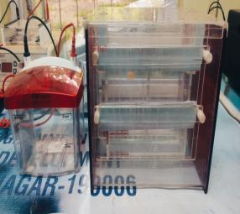
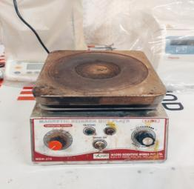
PLACEMENT BROCHURE
2024
Incubators
SDS Assembly large and small
Magnetic stirrer
11

Slide 13
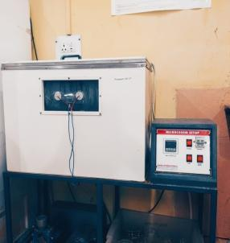
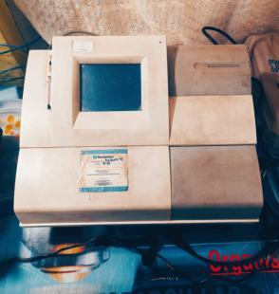
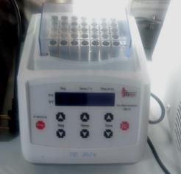
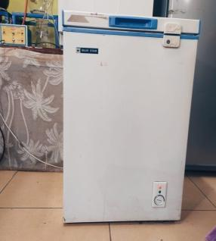
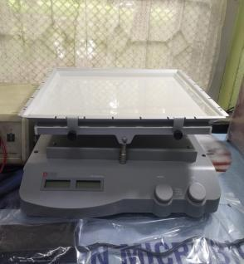
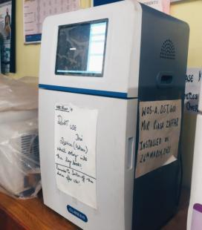
PLACEMENT BROCHURE
2024
Microcosom SetUp
ELISA Reader
Dry bath
Freezer minus 20
Gel Rocker
Gel Doc

Slide 14
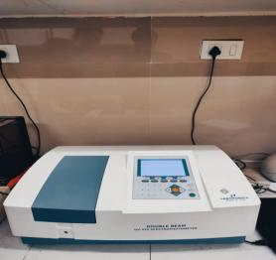
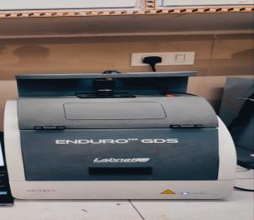
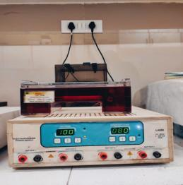
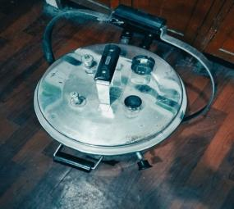
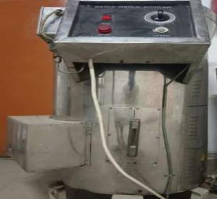
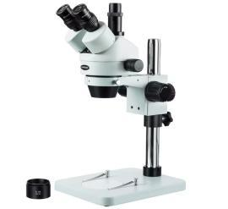
Elevated Plus Maze
Spectrophotometer
Gel Documentation system
Electrophoresis Unit
PLACEMENT BROCHURE
2024
Student’s Organ Bath
Autoclaves
3.5X-45X Zoom Trinocular Stereo Microscope
15
Electro-Convulsometer
Rota Rod Apparatus
13

Slide 15
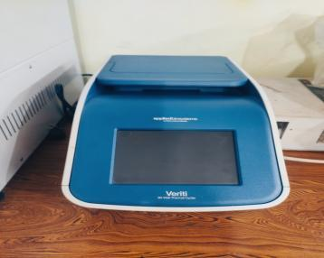
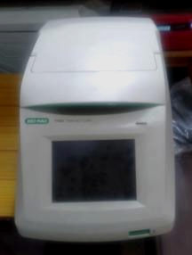
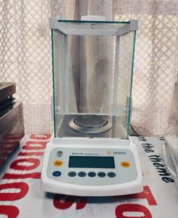
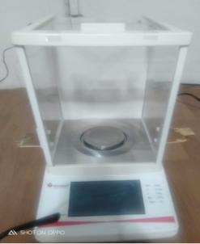
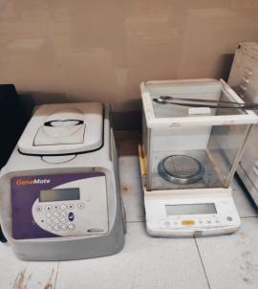
PLACEMENT BROCHURE
2024
PCR Thermal Cycler
Rota-Vapour
16
Vacuum Oven
Digital Balances
Furnae
14

Slide 16
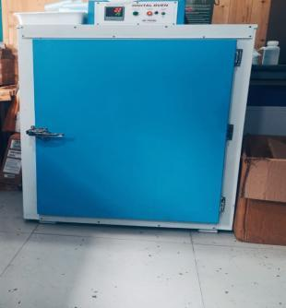
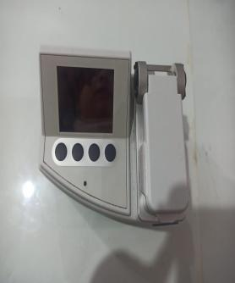
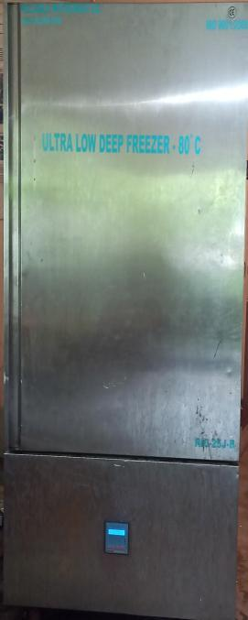
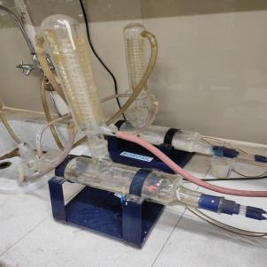
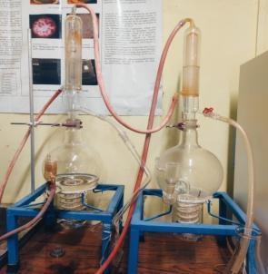
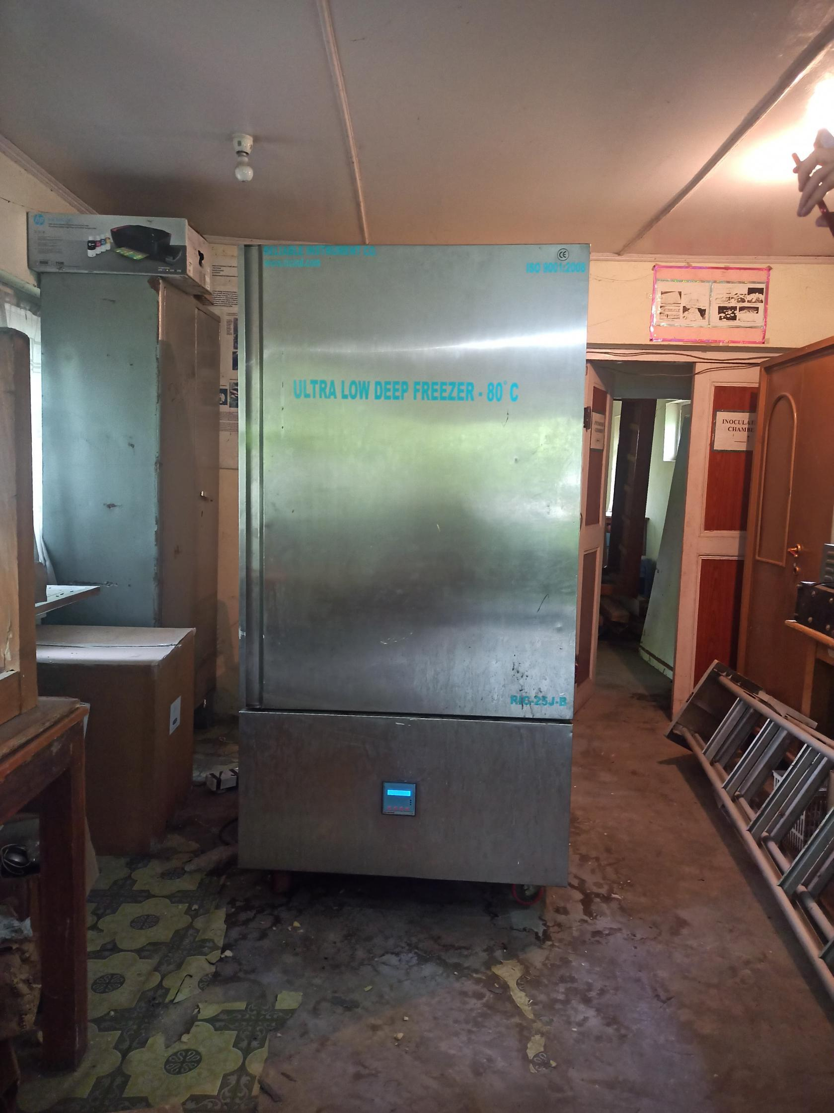
PLACEMENT BROCHURE
2024
Oven
Nanodrop
Distillation Units
Freezer Minus 80

Slide 17
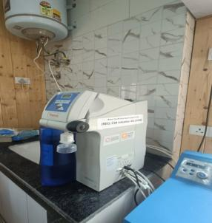
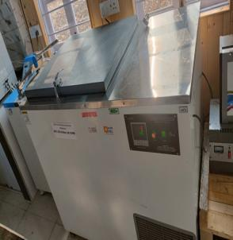
M I L L S
B A L L
PLACEMENT BROCHURE
2024
Millipore Water System
Deep Freezer
Mill
C u t t e r M i l l s
Multi
Bone Homogenizer
Minus 40
Plant Growth Chamber

Slide 18
VV
PLACEMENT BROCHURE
2024
Refrigerator
Microscopic Colony Counter
20
16
Vortex
Laminar Air flow

Slide 19
Director’s Directory
PLACEMENT BROCHURE
2024

Slide 20
Workshops/Seminars Attended
2020-2024
Online Two Days "SPARC-Indo-US Immunology Workshop"organized jointly by IIT Ropar, Punjab & George Washington University, USA held on 12th and 13thJune, 2020.
Workshop entitled “Working in BSL-III Laboratory and Practices for Handling Mycobacterium tuberclosis” organized by University of Delhi, South Campus from 22nd- 28thNovember, 2021.
Two Day Workshop on title “Hands on Training and Workshop on Real Time PCR” organized by CSIR-IIIM on 17th and 18thMarch, 2021
One Week Online Training Program On ‘Biostatistics’ (February 21 – 27, 2021) from Science Institute Lucknow.
One day work shop for ‘signing a MOU’ between Vigyan Prasar and Kashmir University and Central University for Prioritizing Science in Kashmiri Language held in Degree College Charisharief Budgam (Sept.,30 ,2021).
One day workshop on “Towards Quality Enhancement of University Publications” organized by Directorate of Internal Quality Assurance (DIQA), University of Kashmir, Srinagar on 20. 12. 2022
Three Day Workshop on “Science Translation in the Urdu Language” as a Resource person on (SCOPE) by CUK in Collaboration with Prsar Vigyan New Delhi “dated 24/26 - 03-2022 Central University of Kashmir, Main Campus Tulmulla, Ganderbal.
Three days workshop on ‘Basic Techniques in molecular Biology’ from 21 to 23 February, 2022 in Centre of Research for Development, university of kashmir.
Chaired as session on “Regional Young Investigators Meeting (RYIM),Srinagar on theme “Igniting Curiosity and Training young minds of J&K for Sustainable future” Organized by University of Kashmir, held on 19-21 Sept.,, 2023
Two day workshop on ‘Fundamentals of enzymes and emerging concepts’ in Centre of Research for Development, University of kashmir on 21 september, 2023.
Two day workshop on, “Hands-on training on techniques for isolation of DNA and quantitative PCR for environmental and forensic samples” Organised by: Centre of Research for Development (CORD), University of Kashmir in collaboration with Atal Incubation Center (AIC-CCMB), Laboratory for the Conservation of Endangered Species (LaCONES-CCMB), IKP Knowledge Park Hyderabad, and RECL Jammu6 & 7th March, 2023.
PLACEMENT BROCHURE
2024

Slide 21
Workshops/ Seminars attended
2020-2024
Two Day International Conference on theme “Coronaviruses: Past, Present and Future” organized by SKUAST-K on 10thand 11thMay, 2022.
Workshop on “Reproductive Technologies in Wildlife Conservation” Organized by: Biodiversity and Wildlife Conservation Laboratory at CORD, University of Kashmir and CCMB-Laboratory for Conservation of Endangered Species: 18-20 May 2022
National Seminar on “Recent Advances in Science and Technology for Agriculture Sustainability” organized by Department of Botany, School of Life Sciences, Science Campus, Central University of Kashmir on 5thand 6thJuly, 2022.
International conferences on Microbiological Research: Current challenges and future perspectives” jointly organized by Dept. Of Microbiology, Bhrathidasan University Tiruchirapalli and Microbiologists Society India from 9th January, 2024 to 11th January, 2024.
Three day Workshop on, “Wrap up of tools and techniques in Microbiology” Organised by: Microbiology Research Laboratory and P.G Programme in Microbiology, Centre of Research for Development (CORD), University of Kashmir: 15-17th March.
PLACEMENT BROCHURE
2024

Slide 22
FACULTY DETAILS
Prof. Bashir Ahmad Ganai
M. Sc (Biochemistry), M.Phil, Ph. D (Biochemistry)
Director CORD, University of Kashmir
Gold Medal Awarded by APSI, in TC College Baramati Pune.3rd Feb, 2012
Medal for excellence in Molecular Biochemistry by American Biographical Institute USA
Bharat Jyoti Award for meritorious services, outstanding performance and remarkable role presented by Indian International Friendship Society by the hands of Dr. Bhisma Narain Singh former Governor of Tamil Nadu and Assam.
Certificate of Excellence-2013 for outstanding contribution in the field of Protein Biochemistry and Enzymology by Academy of Plant Science, India on 2nd Feb.2013 at Modi Institute of Management and Technology, Kota Rajasthan, through the Hands of Minister of PWD, Rajasthan Sri Bharat Singh
IMRF in Chandigarh held on 20-22th Feb, 2018
Fellowship Award (Gold medal) by NESA on 9th Dec. 2013 on a National Conference at Jamia Hamdard University, New Delhi through the hands of V.C IGNOU and V.C Jamia Hamdard University (Prof. Mohd Ismail and Dr. G. N.Qazi).
Awarded as Gold Medal on the event of “ International symposium on Biodiversity: Status, Utilization and Impact of Challenging Climatic Conditions organized by Babashaeb Bimrao Ambedkar University, Lucknow, Uttar Pradesh in collaboration with the Indian Academy of Environmental Sciences, Haridwar, Uttarkhand from 30th- 31st Oct.,2014 through the hands of Vice Chancellor R.C Sobti of BBAU.
Certificate of Appreciation received from Colombo University on an event of 2nd International Conference on Ayurveda, Unani, Siddha and traditional Medicine-2014,16-18thDec-2014. Organized by Institute of Indigenous Medicine, University of Colombo Rajagiriya,Srilanka.
Awarded as Fellow of Academy of Plant Science India on 1st Feb, 2015 in Smt, N.M Padalia Pharmacy College, Ahmedabad, Gujrat.
Awarded as Fellow of Academy of Plant Science India on 1st Feb, 2015 in Smt, N.M Padalia Pharmacy College, Ahmedabad, Gujrat.
Certificate of Appreciation received from All India Unani Tibbi Congress, J & K Chapter on 2nd National Summit on Unani Medicine on 12th may 2015, at University of Kashmir, Srinagar J&K.
Adjudged as Best Speaker for the lecture in Climate Change and its effect on Agriculture delivered during technology week (2014-2015) launched with the Theme “Innovative Technology Transfer for Live hood and Entrepreneurship Development” on 24th March 2015, In SKUAST.
Eminent Scientist of the year 2015 Award received in an international conference on the occasion of 2nd International Conference on Environment and Ecology held on 7th March 2016 at Bhrathiar University, Coimbatore, Tamil Nadu, India.
Excellent teacher Award by University of Kashmir with consistent record of grade 4.5/5, since 2013-2016 as per the evaluation by students conducted by DIQA.
Awarded Best Scientist of the year 2017 on the occasion 4th International conference on Environment and Ecology Hosted by Department of Zoology, Gauhati University, Guwahati, Assam in association with International Foundation for Environment and Ecology, Kolkata on 12-14th February 2018.
Awarded as Excellence Award 2017 in Environmental Sciences by IMRF on the eve of International conference on Recent trends on Agriculture, and Biosciences
Best Teacher award from Microbiology Society of India and University of Kashmir
PLACEMENT BROCHURE
2024
20

Slide 23
Prof. Md. Niamat Ali M.Sc (Zoology), M. Phil, Ph. D (Zoology) Former Director of Centre of Research for Development
FACULTY DETAILS
Pool Officer: CSIR, New Delhi, Section of Genetics, Department of Zoology, A.M.U., Aligarh.
Research Associate: CSIR, New Delhi, Section of Genetics, Department of Zoology, A.M.U., Aligarh.
SRF (I. C. A. R., New Delhi) during Ph. D Programme.
JRF (U. G. C, New Delhi) during M. Phil Programme.
National Merit Scholarship (Govt. of West Bengal) during M. Sc. Course.
Dr. Navin Chandra Award for Securing Highest Marks During B. Sc. (Hons.) by University of Burdwan, West Bengal, India.
One day workshop on “Towards Quality Enhancement of University Publications” organized by Directorate of Internal
Quality Assurance (DIQA), University of Kashmir, Srinagar on 20. 12. 2022
One week Training cum Workshop on “Stem Cell Biology” which is organised by Tata Memorial Centre, Advanced Centre
for Treatment, Research and Education in Cancer, Kharghar, Navi Mumbai - 410 210, India, w. e. f 23rd to 28th January,
2017
Three Weeks Capacity Building Programme on “DNA Barcoding of Animals Using Cytochrome-C Oxidase Subunit I (COI)”,
Organized by Rajiv Gandhi Centre for Biotechnology, Centre for Advanced Research and Training in Biotechnology,
Department of Biotechnology, Ministry of Science & Technology, Government of India, Thycaud, Thiruvananthapuram,
Kerala, India.
One Month “Training Cum Workshop on Molecular Biology", Organized by SHRM Bio-technologies, Poddar House,
Madhyamgram, Kolkata-700155, West Bengal, India.
One Month Training Course on “Cloning and Expression of Animal Genes” Organized by Jiwaji University; Gwalior, India.
(sponsored by DBT, New Delhi). University Grand Commission (New Delhi) Recognized this Training Programme as
Refresher Course.
Two Weeks National workshop on “Application of Tissue Culture in Genetic Studies” Organized by National Dairy Research
Institute, Karnal, Hariana, India.
Three Weeks “XIth National Training Programme on Electron Microscopy for Scientific Investigators”, Organized by All India
Institute of Medical Sciences, New Delhi, India.
One Week Training Programme on “Writing a Scientific Paper” Organized by Publication and Information Directorate (PID),
CSIR, Delhi, India.
Three Weeks Capacity Building Programme on “Multimedia and E-content Development” Organized by IUAC Campus,
Aruna Asaf Ali Marg, New Delhi in collaboration with EMMRC, Kashmir University, Srinagar – 190 006, J & K, India.
Three Weeks National Training Programme on “Experimental Parasitology, Molecular Biology and Immunodiagnostics”,
Organised by P .G. Department of Zoology, University of Kashmir, Srinagar-190 000, J & K, India.
Ten Days National Workshop on “Experimental Parasitology and Immunodiagnostics”, Organized by P. G. Department of
Zoology, University of Kashmir, Srinagar-190 006, J & K, India.
One Week Workshop on “Internet Assessment and Online Information Retrievals”, Organized by Indian National Science
Documentation Centre, New Delhi, India.
One Week Workshop on “Electron Microscope, X- Ray Diffraction and their Application in Material Sciences and Biological
Sciences”, Organized by USIC, Jadavpur University, Kolkata, West Bengal, India.
One Year Diploma Course in Statistics, A. M. U., Aligarh, India.
PLACEMENT BROCHURE
2024
22
21

Slide 24
Dr. Ruqeya Nazir Sr. Assistant Professor
M.Sc (Toxicology), Ph.D (Microbiology)
Nodel officer
Received an award citation memento and a medal for “Distinguished Microbiologist” in an international conference on theme “International conferences on Microbiological Research: Current challenges and future perspectives” jointly organized by Dept. Of Microbiology, Bhrathidasan University Tiruchirapalli, Tamil Nadu and Microbiologists Society, India from 9th January, 2024 to 11th January, 2024.
Chaired and adjudged a technical session in an international conference on theme “International conferences on Microbiological Research: Current challenges and future perspectives” jointly organized by Dept. Of Microbiology, Bhrathidasan University
Tiruchirapalli and Microbiologists Society India from 9th January, 2024 to 11th January, 2024.
For the first time in the UT of J&K, National Symposium on “World Microbiome Day” was organized and celebrated under the theme “Microbiomes for Life: Celebration of the Microbial World” on 27thJune, 2022.
Co-chaired and adjudged the technical session in the National Seminar on “Recent Advances in Science and Technology for Agriculture Sustainability” organized by Department of Botany, School of Life Sciences, Science Campus, Central University of Kashmir on 5thand 6thJuly, 2022.
Served as a Judge in the technical session of “World Environment Day” under theme 7 “Living Sustainably in Harmony with Nature: As there is only One Earth” organized by Department of Environmental Sciences, University of Kashmir on 6th June, 2022.
President of Microbiologists Society, India (J&K Chapter) for the Academic Calender (2020) and continued till date.
Received a Feedback Score of 8 (Excellent) on a Scale of 10 from the P.G. students of Microbiology issued by Dean, School of Biological Sciences.
Served as a Judge in a “Competitive Session on Microbiology” during the oral presentations
in the 13th Session of Jammu and Kashmir Science Congress(JKSC-2018),organized from2nd - 4th April, 2018 by University of Kashmir in collaboration with the J&K State Science Technology and Innovation Council.
Received “Third Prize Award” in the Fifth JK Women Science Congress(JKWSC-2018) or presenting a paper on “Influence of Influenza A Virus in the Recruitment of Th1 /Th2 Immune Responses in the Lungs of Murine Model of Allergic Asthma”, during “Emerging Trends in Science: Role of Women”Orgnized by Govt. College for Women, M.A. Road, Srinagar, funded by J&K State Science Technology and Innovation Councilfrom 27thto 29thMarch, 2018.
Received “Certificate of Appreciation” in National seminar on “Environmental Pollution: Join the Race to make the World a Better Place” on the eve of observance of World Environment Day - 2016, organized by Department of Environmental Science and Centre of Research for Development (CORD), University of Kashmir.
PLACEMENT BROCHURE
2024
24
22

Slide 25
Dr. Zaffar Bashir
M.Sc & Ph.D (Microbiology)
Contractual lecturer
Best poster presentation award in 2 days National work shop 27, 28 Sept. 2017, Cluster University, Kashmir, women college M.A. Road Srinagar.
Poster presentation award SKUAST-J. International conference on recent trends in Bioinformatics and a Biotechnology for sustainable development organized by SKUAST-J.12 -13 Oct.2017
Best poster presentation award, two days national conference conducted by Zoology department of Kashmir University and zoological society of India,5-6 August,2018.
Best thesis award at 3rdinternational conference “Global initiatives in Agriculture and Applied Sciences for Eco Friendly Environment (GIASE-2019) during 16-18 June,2019.Tribhuvan University,Kathmandu.
PLACEMENT BROCHURE
2024
Appreciation Certificate by PI NMHS Project. Entitled “Collection, Characterization, Conservation, and utilization of important genetic resources of hilly regions of J & K and Ladakh”
Appreciation Certificate on presentation of research paper,by Department of environmental sciences and IQAC Govt. S.A.M. Degree College, Budgam (J&K) one day national conference,on 26th Oct.2017
Appreciation Certificate by SKUAST -Kashmir on NSS course of 120 hours during spring semester 2015.
Dr. Burhan Hamid
M.Sc & Ph.D (Microbiology)
Contractual lecturer
Certificate of Appreciation awarded for qualifying quiz on the topic “COVID-19 Community Awareness & Safety” conducted by D Y Patil University School of Pharmacy, Navi Mumbai & Indian Pharmaceutical Association Community Pharmacy Division, held during 25th April to 3rd May 2020.
25
23

Slide 26
Certificate of Appreciation awarded for successful compilation of Ladakh based research project entitled “Entrepreneurship development of flowering bulbous crops in Ladakh Region of J&K state” funded by DST-CODER, New Delhi on 25th March, 2017.
Certificate of Appreciation awarded for remarkable contribution to the research project entitled “Use of Dal Lake Weed as a source of nutrient medium for the growth and yield of Gladiolus, Tulip and Lilium” funded by TDT Division, DST New Delhi on 24th July, 2019.
Certificate of Participation for One Day Online Workshop organized by Department of Bio-resources, University of Kashmir in collaboration with Elsevier on “Planning and organizing research using Elsevier tools: Science direct, Scopus and Mendeley” held on 26th April, 2020.
Certificate of Appreciation awarded in recognition of participation in Three-day Training Workshop organized by Centre of Research for Development (CORD), University of Kashmir, Srinagar on “Wrap up of tools and techniques in Microbiology” held on 15th to 17th March, 2023.
Dr. Parvaze Ahmad Wani
M.Sc & Ph.D (Microbiology)
Contractual lecturer
PLACEMENT BROCHURE
2024
Awarded young scientist award by Govt. of Jammu and Kashmir India, for the year 2007
Awarded Post doctoral fellowship by University Grants Commission of India in the year 2009
Best Teacher ward, Crescent University, Abeokuta, Nigeria for the year 2017Certificate of Outstanding Contribution in Reviewing by Elsevier in April 2018
Certificate of Outstanding Contribution in Reviewing by Elsevier in August 2018
Letter of Commendation for Accreditation Exercise for the year 2018Awarded post doctoral fellowship by UGC of India
Awarded Young Scientist award by Govt. of Jammu and Kashmir, India
Dr. Ulfat Nazir
M.Sc & Ph.D (Microbiology
Contractual lecturer
International Journal of Current Microbiology and Applied Sciences Biocontrol Potential of Plant Growth Promoting Rhizobacterium (PGPR)- Pseudomonas
against Plant Pathogenic Fungi Ulfat Nazir, M. Y. Zargar, Z. A. Baba, S. A. Mir, F. A. Mohiddin and N. A. Bhat 2319-7706
International Journal of Chemical Studies Isolation and characterization of plant growth promoting rhizobacteria associated with pea rhizosphere in North
Himalayan region Ulfat Nazir, MY Zargar, ZA Baba, SA Mir, FA Mohiddin and NA Bhat 2321-4902
International Journal of Current Microbiology and Applied Sciences Characterization of Siderophore Producing Rhizobacteria and its Effect on
Growth of Pea. Ulfat Nazir and M. Y Zargar 2319-7706
26
24

Slide 27
Technical Staff
Name | Designation | Qualification | Specialization /Expertize
Dr. Shazia Bashir | Senior Scientist Technical | M.Sc, M. Phil, Ph.D (Zoology) | Parasitology Entomology
Dr. Sumaira Tyub | Senior Scientist Technical | M.Sc, M. Phil, Ph.D (Botany) | Microbial Ecology Plant Tissue Culture Plant Ecology
Dr. Rubiya Dar | Junior Scientist - C | M.Sc, M. Phil, Ph.D (Biochemistry) | Biochemistry Molecular Biology
Dr. Bilal A. Wani | Junior Scientist – C | M.Sc, Ph.D (Botany) | Wood Anatomy, Wood Variation and its causes, Medicinal Plant Research
Mr. Javeed A. Javeed | J.T.A | M.Sc. Chemistry | Computer Application
PLACEMENT BROCHURE
2024
27
25

Slide 28
Distinguished Alumni
Sl. No | Name | Designation | Affiliation | Degree perused from CORD | Year of Passing (Highest degree)
1. | Uqab Ali Baba | Assistant Professor | SRM University, Delhi | PhD | 2020
2. | Parveena Firdous | C- Lecturer | Higher sec Pulwama | PhD | 2023
3. | Jeelani Ah. Dar | Teacher |  | PhD | 2024
4. | Raies Raja | Teacher |  | PhD | 2023
5. | Sabiha Rahman | Guest-Lecturer | North campus UoK | PhD | 2023
6. | Jahageer Ah. Lone | Sub- Inspector | Shadipora | M.Sc | 2022
7. | Saleem Farooq | Guest-Lecturer | S.P, Srinagar | P h.D | 2021
8. | Neesa Majid | Research Assistant | VRDL, Baramulla | M.Sc | 2022
PLACEMENT BROCHURE
2024

Slide 29
M.SC Microbiology Outgoing Batch
 | Sana Zahoor
 | Parentage | Zahoor Ahmad Baba
 | Residence | Kokerbagh, Zoonimar, Soura, Srinagar
 | Phone no | 9419403222
 | E mail | sanazahoorbaba@gmail.com
 | PG Research Project Title | Dissecting the role of histone methyl transferase in Saccharomyces cerevisiae
 | Area of interest | Molecular Biology
PLACEMENT BROCHURE
2024
 | Aneeka Rizwan
 | Parentage | Habib Ullah Hajam
 | Residence | Kupwara
 | Phone no | 780919910
 | Email | aneekarizwan@gmail.com
 | PG Research Project Title | ANTIBIOTIC SENSITIVITY ON THE CULTIVABLE GUT BACTERIA FROM INDIAN MEDICINAL LEECH (Hirudinaria medicinalis)
 | Area of Interest | Antibiotic Resistance

Slide 30
 | Abas Ahmad Khan
 | Parentage | Mushtaq Ahmad Khan
 | Residence | Kupwara
 | Phone no | 7051668267
 | Email | abask9522@gmail.com
 | PG Research Project Title | Hydrocarbon degradation by bacteria isolated from petroleum contaminanted soil of bus yard of Parimpora Srinagar
 | Area of Interest | Bioremediation
PLACEMENT BROCHURE
2024
 | Bisma Rasool
 | Parentage | Ghulam Rasool
 | Residence | Fateh Kadal, Srinagar
 | Phone no | 9149845701
 | Email | bismabashir1997@gmail.com
 | PG Research Project Title | Isolation and characterization of Gut microbiota from native earthworm species
 | Area of Interest | Pure Culturing, Molecular Biology

Slide 31
 | Rifat Rashid
 | Residence | Baramulla
 | Phone no | 6005452994
 | Email | rifatrashid1000@gmail.com
 | Project Title | Study on amylolytic potential of bacterial strains isolated from potato field of kashmir, India.
 | Area of Interest | Agricultural Microbiology
PLACEMENT BROCHURE
2024
 | Sakidah Manzoor
 | Parentage | Manzoor Ahmad Rather
 | Residence | Srinagar
 | Phone no | 7006590089
 | Email | sakidahmanzoor2015@gmail.com
 | PG Research Project Title | Characterization of Heavy Metal Resistant Phosphate Solubilizing Bacteria Isolated from Contaminated Soils of Cement Industry
 | Area of Interest | Agricultural Microbiology
31
29

Slide 32
 | Shagufta Majeed
 | Parentage | Ab. Majeed Dar
 | Residence | Kunzar, Baramulla
 | Phone | 7051563045
 | Email | darshugufta884@gmail.com
 | PGResearch ProjectTitle | Studies on diversity of potassium solubilizing bacteria (KSB) from rhizospheric soils of Kashmir Iris ( Iris kashmiriania), from graveyards of North Kashmir, India
 | Area ofInterest | Agricultural Microbiology
PLACEMENT BROCHURE
2024
 | Noor Mohmad Bhat
 | Residence | Srinagar
 | Phone no. | 9103045958
 | Email | noorbhat88@gmail.com
 | Project Title | Morphological and biochemical characterization of post harvest pathogens in tulip garden nehru memorial botanical garden chesthamashi Srinagar Jammu and Kashmir .
 | Area of Interest | Medical Microbiology
32
30

Slide 33
 | Tawzia Jan
 | Parentage | Tariq Ahmad Zarger
 | Residence | Srinagar
 | Phone no | 7006657902
 | Email | zargartowzia45@gmail.com
 | PG Research Project Title | Evaluation of innate endophytes in saffron of Ladhoo village of pulwama
 | Area of Interest | Antipathogencity and antibiofilim activities
PLACEMENT BROCHURE
2024
 | Danish Showkat
 | Parentage | Showkat Ahmad Bhat
 | Residence | Srinagar
 | Phone No. | 9797032792
 | Email | danishb889@gmail.com
 | PG Research Project Title | Isolation, Characterization, Identification of Probiotic Bacteria from Traditional Kashmiri Fermented Cow Clostrum Cheeze (phuh) and Evaluation of their probiotic potentail
 | Area of Interest | Medical Microbiology
33
31

Slide 34
 | Aadil Hussain
 | Parentage | Ghulam Nabi Dar
 | Residence | Budgam
 | Contact details | 7889502066
 | Email | nudaadil@gmail.com
 | PG Research Project Title | Optimization and Recombinant Expression of Toxic Plant Protein, NTAAA1
 | Area of Interest | Medical Microbiology
PLACEMENT BROCHURE
2024
Ongoing Research Projects
DBT sponsored project untitled Process optimization and upscale production of lignocellulosic extremozymes from Himalayan microbes.
Gut Microbiota heterogeneity in Obese- type 11 Diabetic Mellitus.
Expression analysis of GSTPI and IDHI genes in Primary Malignant Brain tumor tissues of patient exposed to pesticides.
Studies on morphological and molecular profiling through DNA Barcoding of predominant species of Coccinellidae and Syrphidae, their potential in insect pest management in kashmir India
32

Slide 35
Important publication list since 2020
M Nabi, N Tabassum, BA Ganai. (2022). Phytochemical screening and antibacterial activity of Skimmiaanquetilia NP Taylor and Airy Shaw: A first study from Kashmir Himalaya. Frontiers in Plant Science 13. ISSN; 1664-462X.,I.F=6.627
Baba Uqab, Ruqeya Nazir, Bashir Ahmad Ganai, Praveen Rahi. (2022). Invitro sequestration of Molecular and Mass Spectra Characterized Metallophilic Cadmium Tolerant Bacteria for Sustainable Agriculture. Frontiers in Microbiology. 951. Frontiers. .I.F=6.06
P Firdous, P Firdous, K Nissar, SR Masoodi, JA Wani, T Hassan, BA Ganai.(2023). HNF1α upregulation and promoter hypermethylation as a cause of glucose dysregulation: A case–control study of Kashmiri MODY population. Journal of Endocrinological Investigation 46 (5), 915-926. Springer I.F= 5.4.
P Firdous, P Firdous, K Nissar, SR Masoodi, JA Wani, T Hassan, BA Ganai.(2023). HNF1α upregulation and promoter hypermethylation as a cause of glucose dysregulation: A case–control study of Kashmiri MODY population. Journal of Endocrinological Investigation 46 (5), 915-926. Springer I.F= 5.4.
K Nissar, P Firdous, A Hussain, S Bashir, Z Ahmad, BA Ganai.(2023). Transcriptomic Downregulation of APOE, Polymorphic Variations of APOE, Diet, Social Isolation, and Co-morbidities as Contributing Factors to Alzheimer’s …. Molecular Neurobiology, 1-11. Springer..I.F= 5.15.
Hina Mushtaq, Bashir Ahmad Ganai, ArshidJehangir.(2023).Exploring soil bacterial diversity in different micro-vegetational habitats of Dachigam National Park in North-western Himalaya. Scientific Reports. 13(1).3090.Nature Publishing Group UK. I.F= 4.96
Nazima Rashid, Shahid Ahmad Ganiee, M Sultan Bhat, Bashir Ahmad Ganai.(2023).“Valorization of aquatic plant Nymphaea mexicana for biofuel production: an emerging source of bio-renewable energy. Environment, Development and Sustainability. Springer International Publishing. I.F=4.9
S Hassan, Sabreena, SA Ganiee, A Yaseen, M Zaman, AJ Shah.(2023). Unraveling the potential of environmental DNA for deciphering recent advances in plant–animal interactions: a systematic review. Planta 258(6), 117. Springer , I.F=4.8
Shahnawaz Hassan, Sartaj Ahmad Bhat, Vineet Kumar, Bashir Ahmad Ganai, Fuad Ameen.(2022). Phytoremediation of Heavy Metals: An Indispensable Contrivance in Green Remediation Technology. Plants., 11((9).1255(MDPI). . ISSN; 2223-7747.,I.F=4.658
S Hassan, BA Ganai. (2023). Deciphering the recent trends in pesticide bioremediation using genome editing and multi-omics approaches: a review. World Journal of Microbiology and Biotechnology 39(6), 151 Springer .I.F=4..2
F Bashir, A Bashir, N Bouaïcha, L Chen, GA Codd, B Neilan, WL Xu,.(2023). Cyanotoxins, biosynthetic gene clusters, and factors modulating cyanotoxin biosynthesis. World Journal of Microbiology and Biotechnology 39(9), 241. Springer.I.F= 4.2.
H Mushtaq, SA Ganai, A Jehangir, BA Ganai, R Dar.(2023). Molecular and functional characterization of protease from psychrotrophic Bacillus sp. HM49 in North-western Himalaya. PloS one 18 (3), e0283677 I.F=3.7
Sabira Hafeez, Sabba Yaqoob, Aqib Rehman Magray, Azra N Kamili, Bashir Ahmad Ganai. (2023). Molecular characterization of fungal endophyte diversity isolated from Aconitum heterophyllum: a critically endangered medicinal plant of Kashmir Himalaya. International Microbiology.1-12. Springer International Publishing. I.F=3.4.
NajeebulTarfeen, Shariq Rashid Masoodi, Khair Ul Nisa, Shafat Ali, Mir Bilal Ahmad, Bashir Ahmad Ganai. (2023).VDR downregulation and promoter hypermethylation as one of the causes for triggering type 2 diabetes mellitus: Clinical and molecular studies.Journal of Diabetes & Metabolic Disorders.pp-1-9. Springer International Publishing. I.F=2.8
Burhan Hamid, Neesa Majeed, Bashir Ahmad Ganai, Shahnawaz Hassan, Zaffar Bashir, Parvaze Ahmad Wani, Kahkashan Perveen, RZ Sayyed. (2023).Heavy‐metal tolerant bacterial strains isolated from industrial sites and scrap yards in Kashmir, India. Journal of Basic Microbiology. Willey Publication I.F=2.65.
Nazima Rashid, Shahid Ahmad Ganiee, M Sultan Bhat, Bashir Ahmad Ganai. (2023).Comparative biochemical analysis and GC–MS phytochemical profiling in some aquatic plants. Chemical Papers.1-16 Springer International Publishing. I.F=2.1
NajeebulTarfeen, Khair Ul Nisa, Shariq Rashid Masoodi, Humaira Bhat, Saba Wani, Bashir Ahmad Ganai(2023). Correlation of Diabetes Related Factors with Vitamin D and Immunological Parameters in T2DM Kashmiri Population. Indian Journal of Clinical Biochemistry.pp-1-7. Springer India. I.F= 2.1
NajeebulTarfeen, Khair Ul Nisa, Mir Bilal Ahmad, Ajaz Ahmad Waza, Bashir Ahmad Ganai.(2023).Metabolic and genetic association of vitamin D with calcium signaling and insulin resistance. Indian Journal of Clinical Biochemistry:38(4).407-417 Springer India. I.F= 2.1
PLACEMENT BROCHURE
2024
35
33

Slide 36
Ali Mohd Yatoo, Basharat Hamid, Tahir Ahmad Sheikh, Shafat Ali, Sartaj Ahmad Bhat, Sudipta Ramola, Md. Niamat Ali, Zahoor Ahmad Baba, Sunil Kumar (2024): Global perspective of municipal solid waste and landfill leachate: generation, composition, eco‑toxicity, and sustainable management strategies. Environmental Science and Pollution Research (Springer-Verlag GmbH Germany, part of Springer Nature:) Impact Factor = 5. 80
Shafat Ali, S Majid, Md Niamat Ali, M. Z. Banday and S Taing (2023): Understanding the potential immunogenetic role of TNFα-308 polymorphism in the pathogenesis of recurrent miscarriage, Heliyon: 9 (4): e15166. DOI: 10.1016/j.heliyon.2023.e15166; PMCID: PMC10106509; PMID: 37077690 Impact Factor = 3.78
Shafat Ali, M. U Rehman, A. M Yatoo, A. Arafah, A. Khan, S. Rashid, S. Majid, Md. Niamat Ali (2023) TGF-β signaling pathway: Therapeutic targeting and potential for anti-cancer immunity, European Journal of Pharmacology, 175678) Impact Factor =5.20
Shahid Hameed , Tawqir Bashir , Mohammad Niamat Ali, Munib Khanyari and Ajith Kumar (2023): Recent studies on Indian primates show declining population trends, even in protected areas. Oryx: The International Journal of Conservation (Cambridge University Press ISSN 00306053, 13653008) doi:10.1017/S0030605323000716 https://doi.org/10.1017/ S0030605323000716 Published online by Cambridge University Impact Factor = 2.7
Junaid Bashir, Mudasir Mehraj1, Zakir Husain Khna and Md. Niamat Ali (2023): Biological Control of Insect and Fungal Pests by Predominant Coccinellidae Beetles-A Review. International Journal of Current Microbiology and Applied Sciences; 12 (9): 277-287 [ISSN: 2319-7706; https://doi.org/10.20546/ ijcmas.2023.1209.027]
Falak Mushtaq, , Md. Niamat Ali and Akhtar Ali Khan (2023): Temperature-dependent Prey Consumption and Functional Response of Episyrphus balteatus De Geer (Diptera: Syrphidae) to Macrosiphum rosae L. (Homoptera: Aphididae) reared on Rosa alba L. under Laboratory Conditions, Eco. Env. & Cons. 29 (May Suppl. Issue):pp.(S501-S508)ISSN0971–765X, DOI No.: http://doi.org/10.53550/EEC. 2023.v29i03s.086 Impact score (IS) = 0.34
Ali Mohd Yatoo, Sartaj Ahmad Bhat, Md. Niamat Ali, Zahoor Ahmad Baba and Zarka Zaheen (2022): Production of Nutrient-Enriched Vermicompost from Aquatic Macrophytes Supplemented with Kitchen Waste: Assessment of Nutrient Changes, Phytotoxicity, and Earthworm Biodynamics; Agronomy (MPDI) 12(6): DOI No. 1303; https://doi.org/10.3390/agronomy12061303 https://www.mdpi.com/journal/agronomy [I.F 3.41]
Shahid Mehmood, Imtiaz Ahmed and Md. Niamat Ali (2022): Length-weight relationship, morphometric and meristic controlling elements of three freshwater fish species inhabiting North Western Himalaya; Egyptian Journal of Aquatic Biology & Fisheries, 25(6): 243 – 257; ISSN 1110 – 6131; www.ejabf.journals.ekb.eg 999 [https://www.scijournal.org/impact-factor] Impact Factor = 1.03
Azra Bashir, Md. Niamat Ali and Masood H. Balkhi (2022): Impact of gonadal development on the proximate composition of muscle, liver and ovary of adult female rainbow trout (Oncorhynchus mykiss), J Fisheries Livest Prod 2022, Vol 10(6): 350 DOI: 10.4172/ 2332-2608.1000350]
I. S. Khan, K. B. Dar, S. A. Ganie, Md. Niamat Ali (2022): Toxicological impact of sodium benzoate on inflammatory cytokines, oxidative stress and biochemical markers in male Wistar rats; Drug and Chemical Toxicology (Elsevier), 45 (3), 1345-1354 ISSN: 0148-0545 (print); 1525-6014 (web). Impact Factor = 5.57
Shafat Ali, S Majid, Md. Niamat Ali, MZ Banday, S Taing, S Wani, M Almuqbil, S Alshehri (2022): Immunogenetic Role of IL17A Polymorphism in the Pathogenesis of Recurrent Miscarriage; Journal of Clinical Medicine (Elsevier),, 11 (24), 7448, 5-Year Impact Factor: 3.098
Ali Mohd Yatoo, Md. Niamat Ali, Zarka Zaheen, Zahoor Baba, Shafat Ali, Tahir sheikh, Basharat Hamid (2022) Assessment of pesticide toxicity on earthworms using multiple biomarkers: a review. Environmental Chemistry Letters (Springer ),1-26. [Doi: 10.1007/s10311-022-01386-0]. Impact Factor = 15.70
PLACEMENT BROCHURE
2024
36
34

Slide 37
Nisa, Marofull, Rouf Ahmad Dar, Bashir Ahmad Fomda, and Ruqeya Nazir. "Combating food spoilage and pathogenic microbes via bacteriocins: A natural and eco-friendly substitute to antibiotics." Food Control 149 (2023): 109710.
Shabir, Uzma, Jehangir Shafi Dar, Aashaq Hussain Bhat, Ruqeya Nazir, and Fuad Ameen. "The hidden world of fish fungal pathogens: Molecular identification and phylogenetic analysis in common carp, Cyprinus carpio." Archives of Microbiology 205, no. 9 (2023): 311.
Dar, Gulam Jeelani, Ruqeya Nazir, Shakil A. Wani, and Saleem Farooq. "Isolation, molecular characterization and first report of Dothiorella gregaria associated with fruit rot of walnuts of Jammu and Kashmir, India." Microbial Pathogenesis 175 (2023): 105989.
Puttoo, Aijaz Nabi, Naveed Nazir Shah, Sandeep Tripa Thi, Ruqeya Nazir, Haamid Bashir, Rehana Kauseer, Himanshu Tripa Thi and Inam ul Haq"Prevalence of Tuberculosis in the North Indian Subcontinent Kashmir Valley: A Cross-sectional Hospital-based Study." Journal of Clinical & Diagnostic Research 16, no. 1 (2022).
Puttoo, Aijaz Nabi, Sandeep Tripathi, Naveed Nazir Shah, Ruqeya Nazir, Haamid Bashir, Aaliya Mohi-ud-Din Azad, and Rehana Kauser. "Inam-Ul-Haq, Anti-Tuberculosis Therapy in The Drug Resistant Tuberculosis Patients of Kashmir Valley.(2023)." Int. J. Life Sci. Pharma Res 13, no. 1: L281-292.
Nazir,R., Ganai,B.A.and Rahi,P.(2022). Invitro Sequestration of Molecular and Mass Spectra Characterized Metallophillic Cadmium Tolerant Bacteria for Sustainable Agriculture. Frontiers in Microbiology. (Impact Factor 6.2)
Farooq,S.A., Nazir,R., Ganai,S.A .and Ganai,B.A.(2022).Molecular Characterization of Lipase from a Psychrotrophic Bacterium Pseudomonassp.CRBC14. Current Genetics, Springer. (Impact Factor 3.5)
Amin, I., Nazir, R. and Rather, M.A. (2021). Nano-Bioremediation: An Innovative Approach for Remedying Heavy Metals using Fungi. Journal of Bioremediaion and Biodegradation. 12:487. (Impact Factor 3.98)
Naziya,K., Tak,H., Nazir,R., Kulsum,B .and Muniza,M .(2021).On the Epidemiology of Helminth Parasites in Hangul Deer Cervus hanglu hanglu (Mammalia: Artiodactyla: Cervidae) of Dachigam National Park, India. Journal of Threatened Taxa. (Impact Factor: 0.56)
Uqab, B., Nazir R., Ganai B. A., Rahi, P., Rehman, S., Farooq, S., Dar, R., and Azbd_ Allah, E. F. (2020). MALDI-TOF-MS and 16SrRNA Characterization of Lead Tolerant Metallophile Bacteria Isolated from Saffron Soils of Kashmir for their Sequestration Potential. Saudi Journal of Biological Sciences. (Impact Factor 4.2)
Zaffar R, Nazir R, Rather MA and Dar R. Biofilm formation and EPS production enhances the bioremediation potential of Pseudomonas species: A novel study from eutrophic waters of Dal lake, Kashmir, India; Archives of Microbiology, 3817 (Impact Factor 2.8)
Amin, I., Zaffar, R., Rather, M. A., & Nazir, R. (2022). Biotic Environment Reinforcing the Pertinacious Clinically Relevant COVID-19 Associated Mucormycosis: First Report From Kashmir Valley, India.
Farooq, R Nazir, I Rashid, GJ Dar Microbial pathogen profiling and water quality assessment of Jammu Himalayan springs Biologia, 1-12 (Impact Factor 1.6)
Amin, I., Zaffar, R., Rather, M. A., & Nazir, R. (2022). Biotic Environment Reinforcing the Pertinacious Clinically Relevant COVID-19 Associated Mucormycosis: First Report From Kashmir Valley, India.
,
PLACEMENT BROCHURE
2024
35

Slide 38
Burhan Hamid, Neesa Majeed, Bashir Ahmad Ganai, Shahnawaz Hassan, Zaffar Bashir, Parvaze Ahmad Wani, Kahkashan Perveen and R. Z. Sayyed(2023). Journal of Basic Microbiology – Wiley1-12, I.F: 3.1
Mohd Ashraf Dar, Burhan Hamid, Garima Kaushik(2023).Temporal trends in the use and concentration of organophosphorus pesticides in Indian riverine waters, toxicity and their risks assessment. Regional studies in marine Sciences-Elsevier; 59;102814, IF: 2.1
Burhan Hamid, Ali Mohd Yatoo, R. Z. Sayyed, R. Dinesh kumar, Jameel M Al-Khayri, Zaffar Bashir, Mika Sillanpää, NeesaMajeed(2023).Microbial-based conversion of food waste for sustainable bioremediation and utilization as compost. Biomass Conversion and Biorefinery –Springer;https://doi.org/10.1007/s13399-023-04794-6 1-15. I.F: 4.1
Kuddus, M., Roohi, Bano, N., Sheik, G.B., Joseph, B., Hamid, B.,Raveendran Sindhu, AravindMadhavan(2024). Cold-active microbial enzymes and their biotechnological applications. Microbial Biotechnology-Wiley; 17, e14467. https://doi.org/10.1111/1751-7915.14467. I.F: 5.7
Humaira Bashir, Zaffar Bashir, Reetika Mahajan, Muslima Nazir, Rakeeb A. Mir · F. A. Nehvi, Sajad Majeed Zargar.Molecular characterization and insights into the origin of commonbean (Phaseolus vulgaris L.) landraces of north western HimalayasThe Nucleus:An International Journal of Cytologyand Allied Topics.2020.SpringerISSN 0029-568X
Showket Ahmad Dar, Sajad Hussain Mir, Zaffar Bashir, Kounser Javeed, Muneer Ahmad Sofi,Mudasir Hassan6, Tashi Dawa, Tashi Dolkar, Sabreena Ashraf, Shafiyah Rashid. Mode of action of biopesticides (virus, fungi, bacteria, protozoa and nematodes) and their symptoms of infestation to insect pests.Multilogicinscience. 2021Vol. X, ISSUE XXXVI,
Zaffar Bashir*.Characterization of Potassium Solubilizing Bacteria from Rhizospheric Soils of Cherry (Prunusavium).Res. Jr. of Agril. Sci.202112(2): 494-496.NAAS:4.50
Mohiddin, F.A.; Bhat, N.A.; Wani, S.H.; Bhat, A.H.; Ahanger, M.A.; Shikari, A.B.; Sofi, N.R.; Zaffar Bashir. Combination of Strobilurin and Triazole Chemicals for the Management of Blast Disease in MushkBudji -Aromatic Rice. Journal of Fungi (MDPI).2021 7 1060. Impact factor.5.7
Parvaze Ahmad Wani, Yusuff Kareem Olusebi, Uzma Wani, Nusrat Rafi, Mohd Sajjad Ahmad Khan (2024) Role of Chromium Reductases, Antioxidants and Biosorption Against Oxidative Damage of Metals by Bacillus cereus. Journal of Basic Microbiology. 1-11. DOI: 10.1002/jobm.202300589. IF 3.1
Parvaze Ahmad Wani, Grace AT, Omobolanle AW, AmaBM, Ishaq MA, Wani A, Jan N, Oluwaseun OI (2024). Anti-microbial, Anti-diabetic and Anti-quorum Sensing Activity of the Essential Oil of Dialium guineense Willd. Grown in South-West Nigeria. Essential Oil Bearing Plants. Accepted. IF 2.4
Parvaze Ahmad Wani, Yusuff K. Olusebi, Bello A. Rilwan (2023) Remediation of hydrocarbons and metals by hydrocarbon utilizing Pseudomonas taiwanensis YSA-17 isolated from soil contaminated with petroleum. Journal of Basic Microbiology. 63: 1426-1439. IF 3.1
Parvaze Ahmad Wani, Adebimpe Nusirat Ebudola, Yusuff Kareem Olusebi, Nusrat Rafi, Sanusi Jadesola Fawzhia O & Oyelami Isaac Oluwaseun (2023). Hydrocarbon Utilizing and Metal Tolerant Bacteria Simultaneously Degrade Hydrocarbons and Detoxify Metals in Petroleum Contaminated Soil. Geomicrobiology Journal. 40 (4): 372-381. IF 2.412
Parvaze Ahmad Wani, Nusrat Rafi, Uzma Wani, Hashirudeen Bilikis A (2023). Simultaneous Bioremediation of Heavy Metals and Biodegradation of Hydrocarbons by Metal Resistant Brevibacillus parabrevis OZF5 Improves Plant Growth Promotion. Bioremediation Journal. 27 (1): 20-31. IF 2.14
PLACEMENT BROCHURE
2024
36

Slide 39
Sumayya Nazir, Md. Niamat Ali, Javeed Ahmad Tantray, Irfan Akram Baba and Arizo Jan, Simona Mariana Popescu, Bilal Ahamad Paray and Aneela Gulnaz (2022): Study of Ultrastructural Abnormalities in the Renal Cells of Cyprinus carpio Induced by Toxicants. Toxics, 10 (4) :177 [DOI: 10.3390/toxics10040177] (Multidisciplinary Digital Publishing Institute: Impact score = 3.79)
Ali Mohd Yatoo, Zarka Zaheen, Md. Niamat Ali, Z. A. Baba and S. A. Bhat (2022). Production of nutrient-enriched vermicompost from aquatic macrophytes supplemented with egg shell, bone meal, banana peel, and tea waste: Assessment of nutrient changes, Agronomy Report [https://doi.org/10.21203/rs.3.rs-1282025/v1]
Mohd Murtaza, Mahrukh Hameed Zargar, Oliyath Ali, Ishfaq Shafi Khan and Md. Niamat Ali (2021): Spectrum and frequency of connexin 26 & connexin 30 gene mutations in patients with congenital hearing loss from Ladakh India. Meta Gene: ISSN: 2214-5400 (Elsevier)) 30 (100960) [DOI: https://doi.org/10.1016/j.mgene.2021.100960] Impact factor: 0.7
R. Raja, Md. Niamat Ali and G. A. Bhat (2021): Nidification record of himalayan monal Lophophorus impejanus, in Gulmarg Wildlife Sanctuary, J & K, India. Uttar Pradesh Journal of Zoology, 42(16): 76-84 [ISSN : 0256-971X(P)
International Journal of Current Microbiology and Applied Sciences Biocontrol Potential of Plant Growth Promoting Rhizobacterium (PGPR)- Pseudomonas against Plant Pathogenic Fungi Ulfat Nazir, M. Y. Zargar, Z. A. Baba, S. A. Mir, F. A. Mohiddin and N. A. Bhat 2319-7706
International Journal of Chemical Studies Isolation and characterization of plant growth promoting rhizobacteria associated with pea rhizosphere in North Himalayan region Ulfat Nazir, MY Zargar, ZA Baba, SA Mir, FA Mohiddin and NA Bhat 2321-4902
International Journal of Current Microbiology and Applied Sciences Characterization of Siderophore Producing Rhizobacteria and its Effect on Growth of Pea. Ulfat Nazir and M. Y Zargar 2319-7706
International Journal of Current Microbiology and Applied Sciences Evaluation of Bacillus strains for Plant Growth Promoting Properties Isolated from Different Regions of Kashmir Valley 2319-7706
International Journal of Current Microbiology and Applied Sciences Characterization of Phosphate Solubilizing Plant Growth Promoting Rhizobacteria Isolated From Pea Rhizosphere (Pisum sativa) Ulfat Nazir and M. Y Zargar 2319-7706
37

Slide 40
PLACEMENT BROCHURE
2024
Prof. Bashir Ahmad Ganai
Director
Centre of Research for development & P.G.programme in microbiology, university of kashmir, Srinagar
38

